Slide 1
Internal Audit Department Overview

Slide 2
The Internal Audit and Infrastructure Services Teams
Internal Audit Project Team | Ayoola Akanni David Ronca Kevin Thomas Sol Vazquez Theresa Zagarino (In-Charge)
Internal Audit Management | DJ Arguello Diane Santiago
AIS Global Security Team | Brenda Ferraro (Point of Contact) Jim Routh (Auditee, EC+1) Maria Spano Chris Krueger Christopher Catania Pamela Flemming
October 2016
2

Slide 3
Project Scope
Audit Name: Third Party Security Risk Management Audit (16212)
Board Strategy:
Audit the governance processes and key controls used to assess and mitigate third-party IT security risk including (1) third-party security risk assessment, (2) security issue identification and remediation, (3) third-party onsite security reviews.
Audit Scope: Third-Party Governance and Risk Management Framework with a focus on the governance and monitoring of third-parties considered a high technology risk. (All tranches)
Audit Objectives:
Review the processes and controls to assess and mitigate third-party security risks including:
• Inventory of third parties; all tranches
• Criteria used to evaluate risk level of third party
• Third-party security risk assessment (initial and on-going) process
• Third-party security issue identification and remediation
• Third-party questionnaire
• Third-party onsite security reviews
Preliminary Risks:
1. Data in motion and at rest at third party location is not appropriately protected
2. Unavailability and instability of systems
October 2016
3

Slide 4
Project Scope (contd.)
Key Process Areas:
Risk Criteria & Categorization/Prioritization:
Third parties are appropriately risk categorized; which drives the frequency and level of security requirements and oversight
Review of control inventory/documentation, criteria and governance expectations
Understanding established risk appetite (inherent & residual risk planning)
Exit Strategy and governance process (when initiated through disengagement) to ensure controls for Data and Operation Protection such as ensuring data removal from Third Party (“TP”).
Governance & Oversight Standards:
Completeness of Third Party Risk Management (“TPRM”) inventory of all third parties (All tranches) contracted with Aetna
Review standards (onsite & questionnaire) – The documentation and process controls in place that facilitates oversight, accountability, monitoring, and on-going risk management;
Frequency of reviews – Scheduling, tracking, and approach (Based on risk tier of the third party). Questionnaires vs on sites
Reporting and communications, including escalation
On-Going Risk Monitoring:
Understanding the assessment of new/evolving risks and/or vendor changes (including how Aetna’s relationship changing) that impact Aetna;
How results of ongoing monitoring activities ensure risks are re-prioritized, re-assignment, and re-classified; and
Reporting and communications, including escalation
October 2016
4

Slide 5
Discussion Points
Current organizational structure overseeing the Third Party Security Risk
Process, tools, or organizational changes that have occurred in the past 12 months
Other corporate , regulatory or business reviews/audits currently underway
Known gaps/risks currently being addressed; as related to this audit
Weekly status meetings and reporting ; Communication & Escalation
Who should be the attendees and status reporting recipients?
Who will be the key contact for this engagement and their back-up?
Who will be the escalation contact for this engagement?
Availability and Blackout Dates
Background on Fieldwork phase of audit engagement
Risk and control focus; evidence and walkthroughs are required
Potential issues will be verbally shared prior to appearing in the status report
Turnaround timeframe for audit requests and inquiries is 48 hours; if this timeframe cannot be met, inform Internal Audit team right away
Status of audit requests will be discussed during status meetings.
October 2016
5

Slide 6
Timeline
Key Milestones | Dates
Issue Engagement Memo | October 17
Align on Business Control Analysis | October 24
Complete fieldwork/testing | November 4
Share Draft Issues List | November 9
Provide Management Action Plans | November 16
Final Audit Report Issued | December 16
October 2016
6

Slide 7
Appendix
October 2016
7

Slide 8
Internal Audit Department
David Doherty
Internal Audit
Zella Foster Executive Assistant
Gerry Berner AA (50%)
Kim Blomker
SR DIR, Finance
Finance Leadership Development Program
Manuel Coello
SR DIR, Informatics
Data Analytics
John Hackendorn
Asst. Head of Internal Audit
Corporate
Dana Himes
SR DIR, Audit Portfolio
Health Care Services
Cara Revett
Executive Director, Audit Portfolio
Commercial & Government
Diane Santiago
Executive Director, Audit Portfolio
Information Technology
October 2016
8
Effective February 4, 2015

Slide 9
Internal Audit Department Mission
Internal Audit Services:
Serves the Audit Committee and assists management in achieving Aetna’s goals by conducting independent and objective assurance and consulting activities.
Objectives are to evaluate and improve the effectiveness of risk management, control and governance processes, and to add value to business operations.
Sarbanes-Oxley Compliance (SOX):
Oversees management's efforts to comply with Section 404 of the Sarbanes-Oxley Act of 2002.
Directs the company's efforts to comply with Section 16 of the National Association of Insurance Commissioners (NAIC) Model Audit Rule.
October 2016
9

Slide 10
Overview of Internal Audit Process
1
2
3
4
5
Co-Develop Expectations
Risk Assessment
Execution
Communicate Results
Audit Plan
Understand/document
Internal Audit Services objectives
Management’s responsibility for controls
Audit protocols
Business goals, objectives, strategies and risks
Develop measurable expectations from audit relationship
Develop customized business process model focusing on
Key business risks
Entity-wide controls
Key performance indicators
Critical success factors
Identify auditable units and risk rate each auditable unit/process
Identify and prioritize specific audits for the period
Develop strategies and preliminary scopes for each audit
Summarize and present risk assessment and audit plan to senior management and Audit Committee
Develop and analyze process understanding and identify risks within processes
Evaluate and test control effectiveness
Communicate risk, control and process issues and co-develop appropriate action plans with management
Conduct anticipatory auditing activities to monitor relevancy of the Audit Plan
Communicate to executive management and the Audit Committee in accordance with agreed protocols:
Status of audit plan and upcoming audit projects
Significant issues identified
Status of managements action plans to resolve issues
Results of customer satisfaction surveys
October 2016
10

Slide 11
Development of the Audit Plan
Overall Objective: Identify the most critical assurance and consulting projects that will assist management in achieving Aetna’s goals.
Key steps include understanding and evaluating:
Continued relevance of previous “key risk” areas
New and emerging key risk areas
Impact of Operating Plan goals on the control environment
Business unit objectives and critical initiatives
Areas of concern, projects and proposed changes identified with Executive Management and members of their respective management teams.
Key changes in the control environment of Aetna’s major processes
Recent audit coverage and results
Key risks identified by: Enterprise Risk Management (ERM); Compliance & Regulatory Affairs (C&RA); and Sarbanes-Oxley (SOX) Compliance
The Audit Plan is developed annually and reviewed for relevancy each quarter in connection with ongoing risk monitoring.
October 2016
11

Slide 12
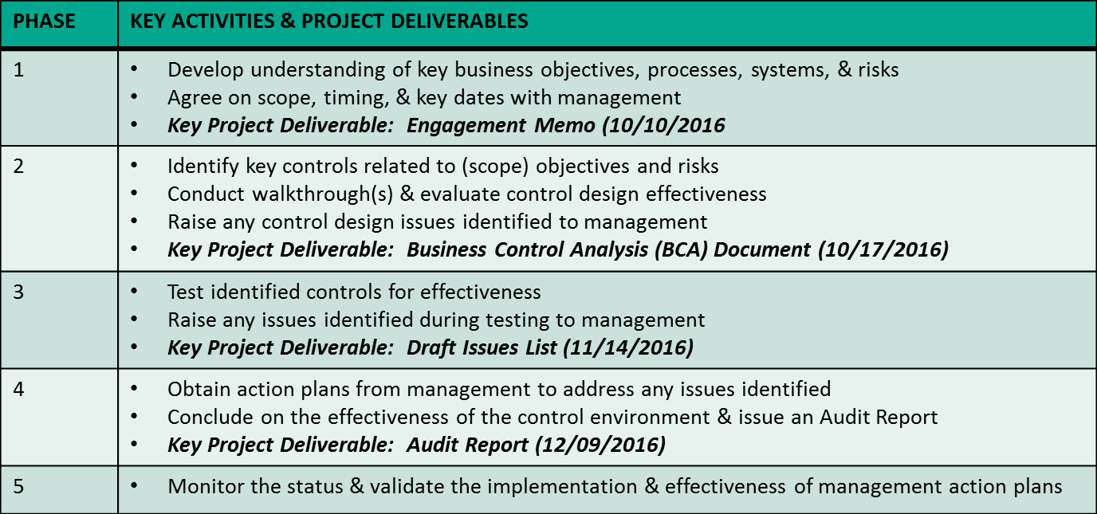
Audit Execution
1
Scoping the Audit
2
Business Control Analysis
3
Testing
4
Conclude the Audit
5
Issue Follow Up
We are here
PROJECT PHASES
October 2016
12

Slide 13
Known Issues
To ensure our audit adds maximum value, discussing issues that are “known” to management during our audit planning is important as this may reduce the time audit staff spends in your area, avoids having auditors duplicate efforts already undertaken by management, and may eliminate the need for unnecessary discussions at the end of fieldwork.
Generally, known issues would not be included as an audit issue provided the issue has been escalated sufficiently to management and a documented and funded action plan exists with deadlines appropriate for the level of risk being addressed – i.e. the lack of action or promptness may be included as an issue.
Reference may be made in the report’s executive summary based on the significance of the risk.
October 2016
13

Slide 14
Components of an Issue
Issue Statement - Identifies the control that: is missing (design issue), or not working (operating effectiveness issue) or is not enforced.
Root Cause Statement - The root cause of an issue answers the question how the issue was allowed to happen. Root Cause will be assessed by applying the following filters:
Types of root causes Areas considered
1st Consider
Awareness
Was anyone aware?
Issues were unforeseen, and no processes (e.g., policy and procedures) existed to address them
Governance Structure
Roles and responsibilities
Communication structure
If aware consider
Capability
Were processes designed correctly?
While processes (e.g., policy and procedures) existed, gaps prevent objectives from being met
Resources and tools
Experience skills and knowledge to identify risk, evaluate the risks importance or execute
MIS and other systems
Organizational / geographical structure
Processes and policies available
If not capability must be
Diligence
Was the control executed as designed?
Processes (e.g., policy and procedures) existed but were executed incorrectly or available resources, tools, policies not used
Culture and tone from the top
Operating goals rewards and incentives
Management focus and priority
Personal motivation
October 2016
14

Slide 15
Issue Priority Ratings
The issue priority rating drives the timing of remediation and also the level of management responsible developing and implementing management action plans.
High: The identified issue requires the immediate attention of department and senior management to prevent the process from becoming ineffective, and an agreed upon action plan for resolution is needed. The issue will be aligned to an Enterprise Risk.
Moderate: The identified issue requires the near-term attention of the responsible manager. There should be an agreed-upon action plan for its resolution.
Low: The identified issue does not warrant immediate attention; however, there should be an agreed-upon plan for ultimate resolution.
High and Moderate issues may include a “tactical fix” while a more strategic solution is determined. As a guideline, timeframes of 60 days and 120 days are suggested for high and moderate issues, respectively.
October 2016
15

Slide 16
Protocol for resolving disagreements on specific audit issues
In instances where there is disagreement between Internal Audit Services and a business area, the Head of Internal Audit will discuss the matter with senior management. If an acceptable decision cannot be reached, the Head of Internal Audit and Senior Management will report the matter to the Audit Committee of the Board of Directors for resolution. Situations which may require such action may include:
Management has accepted a level of residual risk that may be unacceptable to the organization.
Internal Audit is denied access to key data, information or people that may impact the audit findings.
Management disagrees with Internal Audit’s engagement opinion.
Management disagrees with Internal Audit on audit issues or related risk priority ratings.
October 2016
16

Slide 17
Audit Report Ratings
Audit reports contain an opinion on the activity audited and include all significant issues raised along with management's action plans. Each audit report includes one of the following opinions:
Ineffective: Control weaknesses are pervasive or one weakness is so severe that it impacts the entire operation under review. Immediate management attention is needed to remediate the issues identified. Executive Management has oversight responsibility.
Significant Improvement Needed:
One or more significant control weaknesses exist that require prompt action to prevent the process becoming ineffective. Senior Management has oversight.
Effective: Overall, controls are appropriately designed and functioning as intended. Control weaknesses, if noted, do not threaten the effectiveness of the process reviewed. Responsible management has oversight.
Special project reports do not contain an opinion but may contain issues and management action plans.
October 2016
17

Slide 18
Issue Follow-Up Procedures
Management is responsible and accountable for completion of the action plans stated in the audit report and providing a status.
Internal Audit Services performs follow-up work to determine issue closure and whether actions taken remedy the underlying conditions.
The nature, timing and extent of work will vary according to the level of risk and timing of action steps.
Action plan status, including open, closed and those issues behind schedule according to the original estimated completion date, will be reported to executive management on a quarterly basis.
Significant (“high priority”) issues that are behind schedule will be reported quarterly to the Audit Committee.
October 2016
18

Slide 19
Risk Monitoring
Ongoing Risk Assessment:
Keeps the annual audit plan relevant and focused on Aetna’s key risks to assist management in achieving Aetna’s goals.
Validates the audit projects already selected.
Identifies potential audit projects or areas to review based on new or higher priority risks.
Activities performed may involve:
Meetings with management; review of management reports and key performance indicators or 3rd party information; review of new business or new product initiatives; assessment of significant movement in staff or management; assessments of changes to key controls or processes; application releases and other relevant impacts to the business.
October 2016
19

